Slide 1
Pizza Sales Dashboard
Unified mentor

Slide 2
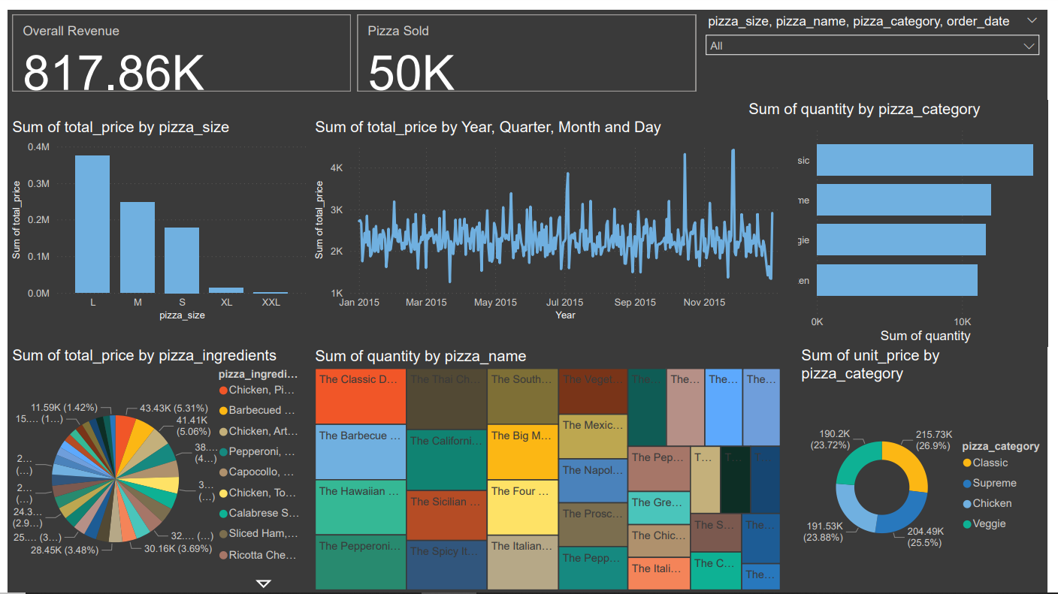
Dashboard of pizza sales dataset

Slide 3
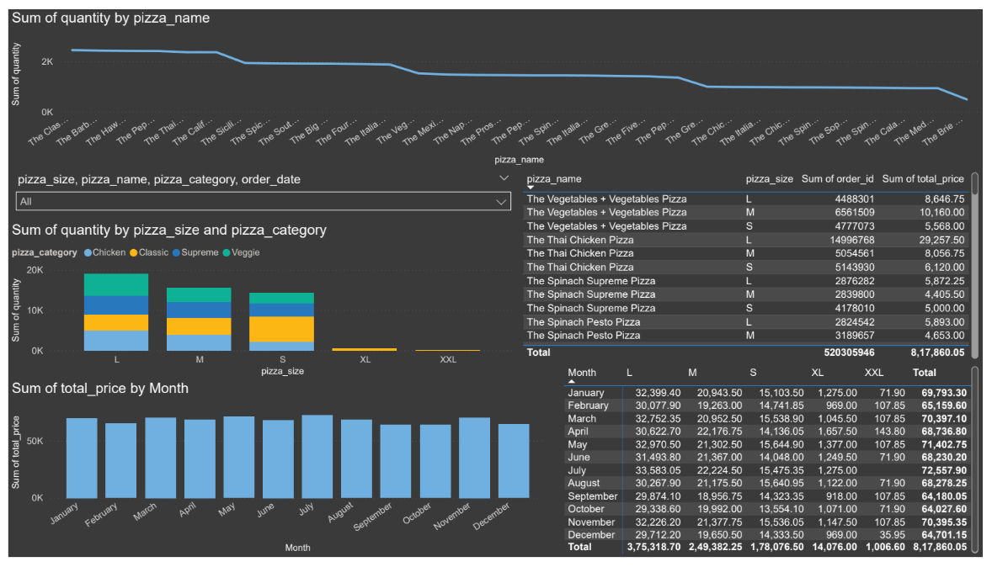

Slide 4
Insights from the dashboard
Overall Performance:
Total revenue: $817.86K.
Total pizzas sold: 50K.
Revenue by Pizza Size:
Larger sizes contribute the most to revenue, with XL and XXL pizzas generating significant total sales.
Quantity by Pizza Category:
Categories like Classic and Chicken are top sellers by quantity, while Supreme and Veggie follow closely.
Trends Over Time:
Monthly revenue varies, with peak months showing over $70K in total revenue (e.g., January and March).
Seasonal trends suggest periods of higher pizza sales, potentially aligning with holidays or special events.

Slide 5
Revenue by Pizza Category:
Classic pizzas lead in revenue, followed closely by Supreme, Chicken, and Veggie categories.
Popular Pizza Types:
Specific pizzas like "The Classic Deluxe," "The Barbecue Feast," and "The Hawaiian Delight" are the most sold items, highlighting customer preferences.
Ingredients Driving Sales:
Ingredients such as chicken, barbecued toppings, pepperoni, and exotic meats contribute significantly to the total price.

Slide 6
Quantity by Size and Category:
Medium and large sizes dominate across categories, particularly for Chicken and Classic pizzas.
Monthly Sales Patterns:
Steady sales throughout the year, with March and May achieving the highest total sales by quantity.
Pizza Variety Insights:
The "Thai Chicken Pizza" and "Spinach Supreme Pizza" perform well across size categories, showing diverse customer tastes.

